Slide 1
SEQUENCE SIMILARITY AND DISTANCE
Affine Indel Gap Model Global Sequence Alignment
By: Cameron Arnold and Matthew Bland

Slide 2
01
LITERATURE REVIEW

Slide 3
Needleman-Wunsch Algorithm
In 1970, Saul B. Needleman and Christian D. Wunsch published a paper on a computer algorithm that finds similarities in the amino acid sequence of two proteins.
Before this, visual comparison was used to reveal sequence coincidence
This algorithm utilizes matrices to evaluate every possible combination of amino acids in a protein sequence
This algorithm was one of the first to use dynamic programming to compare biological sequences

Slide 4
Needleman-Wunsch Algorithm
Start by numbering the 2 proteins (A and B) from their N-terminal end
Number them such that Aj is the jth amino acid of protein A, and Bi is the ith amino acid of protein B
Construct a matrix MATij using Aj as the columns, and Bi as the rows.
This gives you a matrix with every possible comparison between A and B
A pathway of comparison between A and B is represented by a line connecting cells of the matrix
A necessary pathway through the matrix is defined as one that starts at a cell in the first column or row
For the next cell in the pathway either i or j must increase in value, with one of them increasing by exactly one, and the other increasing by one or more
Repeat this procedure until the i and j are equal to their limiting values, M and K, which are the total number of amino acids in the protein sequences A and B

Slide 5
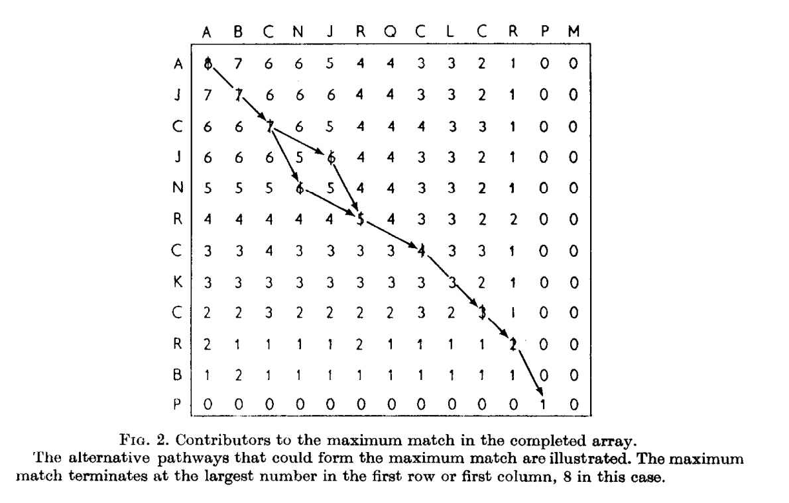
Needleman-Wunsch Algorithm
In the simplest scoring system, MATij is assigned the value one, if Aj is the same amino acid as Bi and is assigned zero if they are different
This scoring system can be increased increased in sophistication if needed, Needleman and Wunsch suggest making each cell value a function of the composition of the proteins.
A penalty factor for gaps may also be introduced, allowing no gaps unless the the benefit from the gap exceeds the gap cost
This algorithm can also be expanded to compare n different proteins with an n-dimensional array

Slide 6
FOGSAA: Fast Optimal Global Sequence Alignment Algorithm
Published in 2013 by Angana Chakraborty and Sanghamitra Bandyopadhyay, FOGSAA is an algorithm that calculates alignment of nucleotide and protein sequences
Compared to the Needleman-Wunsch algorithm, FOGSAA achieves a time gain of 70-90% for highly similar nucleotide sequences (> 80% similarity), and a time gain of 54-70% for moderately similar nucleotide sequences (30-80% similarity)
For other nucleotide sequences, it has approximately the same efficiency
For protein sequences, FOGSAA has an average time gain of 25-40%
Gives exactly the same result as Needleman-Wunsch in less or the same amount of time

Slide 7
FOGSAA
Starts by building a branch and bound tree where every possible alignment of the sequences is represented in root-to-leaf paths
Expand on the branches in a greedy way until the end of the path is reached
At any intermediate point, if a branch is found that is more promising than the current one, it starts expanding on that branch
Repeat this procedure until no other branch is found to be better
At any point, if a branch is deemed no longer promising, it is pruned to save on computation
If less than 30% similarity between the input sequences is found, FOGSAA terminates with an approximate score equal to the best score found so far

Slide 8
FOGSAA
P1 and P2 are defined as pointers to symbols in S1 and S2
Each node of the tree shows alignment between one pair of symbols, which is defined as (0,0) for the root
Each node has a value pair (P1,P2), the Type of alignment (match, mismatch, gap), the Present Score (PrS), and the Fitness Score (T_{max}, T_{min})
A path represents an alignment of a₁,a₂,...,a_{P1}, b₁,b₂,...,b_{P2}, with the last pair of characters being aligned as Type
Starting from the root, FOGSAA either advances both pointers, leading to a match/mismatch, or moves either P1 or P2, while the other remains fixed, introducing a gap in S1/S2 respectively
Therefore, the root can have up to 3 children, (a₁,b₁), (_,b₁), (a₁,_), and each of these can have up to 3 children following the same process. Graded by Fitness Score, only the best nodes will be expanded upon, while the others are inserted in a hashed priority queue ordered by score, possibly expanded upon later

Slide 9
FOGSAA
FOGSAA continues selecting the most fit child based on Fitness Score until the end of the branch is reached
FOGSAA then picks another branch to expand on, starting from a node that has the highest Fitness Score, and is on top of the priority queue
If at any point, the score of the topmost node in the priority queue will give a similarity of less than 30% (this can be changed in parameters), FOGSAA will terminate and return the best alignment and its score
Otherwise, FOGSAA terminates with an optimal alignment of the sequences
Gap score can also be expanded to include affine gap penalties, with the cost being the gap open cost (Go) plus the length of the gap times the gap extension cost (L * Ge)

Slide 10
Gotoh Algorithm
First proposed in 1982, the Gotoh Algorithm was a more computationally efficient alternative to the work done by Waterman et al. in 1976
Waterman et al. extended the Needleman-Wunsch algorithm to allow gaps of any length, but with a time efficiency of M²N (where M and N are the lengths of the proteins or nucleic acids being compared)
Gotoh algorithm essentially has a time of MN, but only if the gap weight follows the form w_{k}=uk + v, (u ≥ 0, v ≥ 0)

Slide 11
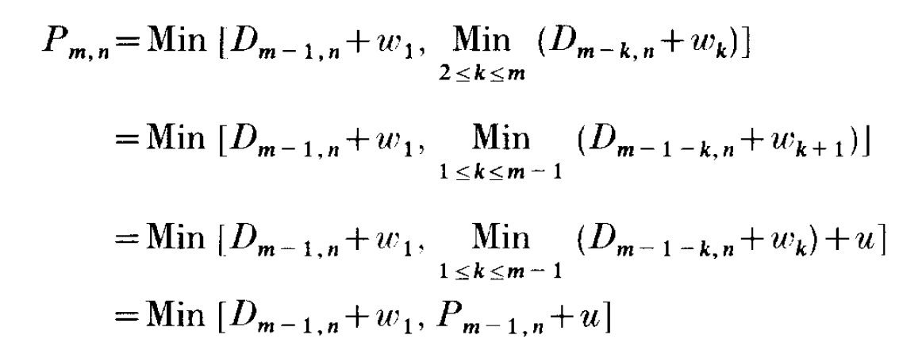
Gotoh Algorithm
Let the two sequences be A = a₁a₂…a_{M} and B = b₁b₂…b_{N} with a weight d(a_{m},b_{n}) defined for each, typically defined with d(a_{m},b_{n}) ≤ 0 if a_{m}= b_{n} and d(a_{m},b_{n}) > 0 if a_{m} != b_{n}
The algorithm from Waterman et al. defines D_{m,n} = min[D_{m-1,n-1}+d(a_{m}, b_{n}), P_{m, n}, Q_{m, n}], where P_{m, n}, Q_{m, n} are calculated in m-1/n-1 steps
Gotoh proposes that these can be calculated in a single step using the following recursive relations And a similar derivation to get Q_{m,n} = Min[D_{m,n-1} + w₁, Q_{m,n-1} + u]

Slide 12
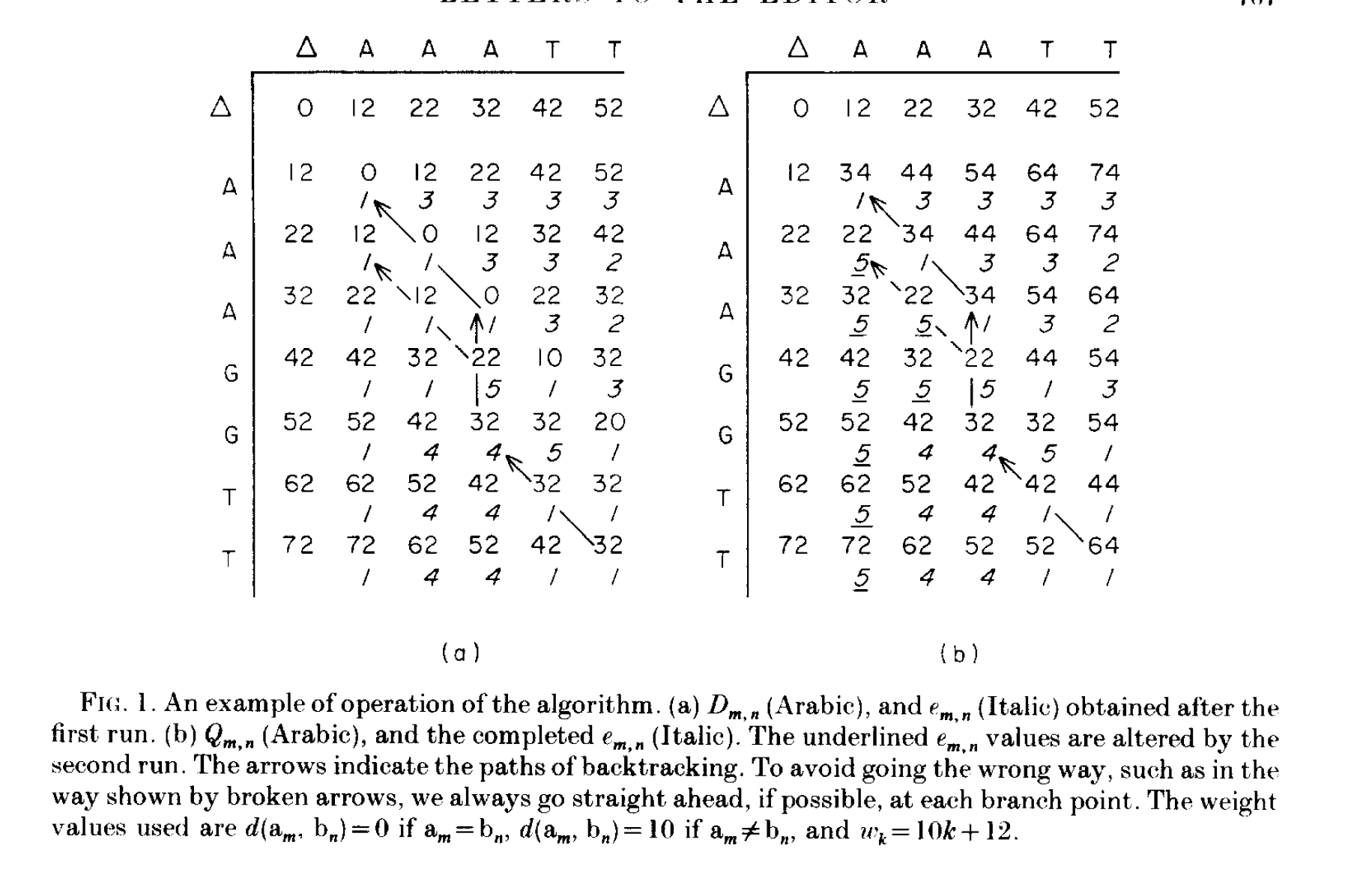
Gotoh Algorithm
Using these definitions, the induction is completed in MN steps, choosing the smallest of the three numbers for D_{m,n} and the smallest of the two numbers for P_{m,n} and Q_{m,n}
Gotoh also notes that all the elements of D_{m,n}, P_{m,n}, and Q_{m,n} do not need to be memorized, but can instead be stored in two temporary one dimensional array, and one variable, improving space complexity

Slide 13
02
ANALYSIS OF ALGORITHM

Slide 14
ALGORITHM STAGES
MATRIX A
Optimal Fit Alignment
MATRIX D
1. INITIALIZE THE MATRICES
2. COMPUTE THE MATRICES
3. TRACEBACK THE MATRICES
Optimal Fit Alignment (ends with deletion of a_{j})
MATRIX I
Optimal Fit Alignment (ends with insertion of b_{j})

Slide 15
1. INITIALIZE THE MATRICES (SIMILARITY)
gap_{init} = -10 gap_{ext} = -2
 | a₀ | a₁ | a₂ | … | a_{m}
b₀ | 0 | -12 | -14 | … | A(0,m)
b₁ | -12 | - | - | … | -
b₂ | -14 | - | - | … | -
… | … | … | … | … | …
b_{n} | A(n,0) | - | - | … | -
 | a₀ | a₁ | a₂ | … | a_{m}
b₀ | -10 | 0 | 0 | … | 0
b₁ | -22 | - | - | … | -
b₂ | -24 | - | - | … | -
… | … | … | … | … | …
b_{n} | I(n,0) | - | - | … | -
 | a₀ | a₁ | a₂ | … | a_{m}
b₀ | -10 | -22 | -24 | … | D(0,m)
b₁ | 0 | - | - | … | -
b₂ | 0 | - | - | … | -
… | … | … | … | … | …
b_{n} | 0 | - | - | … | -
MATRIX A:
A(0, 0) = 0 A(i, 0) = g_{ini} + i * g_{exti} A(0, j) = g_{ini} + j * g_{exti}
MATRIX I:
I(i, 0) = A(i, 0) + g_{ini}
MATRIX D:
D(0, j) = A(0, j) + g_{ini}

Slide 16
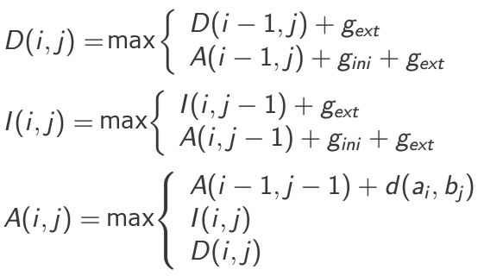
2. COMPUTE THE MATRICES (SIMILARITY)
For sequences a = a₁a₂a₃ … a_{m} and b = b₁b₂b₃ … b_{n} , where 1 ≤ j ≤ m and 1 ≤ i ≤ n, we compute the values for matrices D(i, j), I(i, j) and A(i, j) as follows:
s(a_{i} , b_{j})

Slide 17
3. TRACE THE MATRICES (SIMILARITY)
Start in the bottom-right of matrix A – A(m, n). This is our score
 | - | C | C | A | G | T | G
- | 0 | -12 | -14 | -16 | -18 | -20 | -22
C | -12 | 1 | -11 | -13 | -15 | -17 | -19
C | -14 | -11 | 2 | -10 | -12 | -14 | -16
T | -16 | -13 | -10 | 1 | -11 | -11 | -15
G | -18 | -15 | -12 | -11 | 2 | -10 | -10
MATRIX A

Slide 18
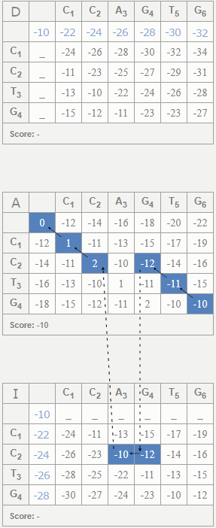
3. TRACE THE MATRICES (SIMILARITY)
2. Move to the cell that this value originated from. Several possibilities:
If we are in Matrix A:
Value originated from A(i-1, j-1) + d(a_{i}, b_{j}) ? Append a_{i} to a’, b_{j} to b’, and move to A(i-1, j-1)
Value originated from I(i, j)? Move to I(i, j)
Value originated from D(i, j)? Move to D(i, j)
If we are in Matrix I, append a_{i} to a’, a gap to b’
Value originated from I(i, j - 1) + g_{ext} ? Move to I(i, j - 1)
Value originated from A(i, j - 1) + g_{ini} + g_{ext} ? Move to A(i, j - 1)
If we are in Matrix D, append a gap to a’, b_{j} to b’
Value originated from D(i - 1, j) + g_{ext} ? Move to D(i - 1, j)
Value originated from A(i - 1, j) + g_{ini} + g_{ext} ? Move to A(i - 1, j)

Slide 19
3. TRACE THE MATRICES (SIMILARITY)
3. Continue until i == 0 or j == 0
If i == 0 and j != 0, then append j gaps to a’ and b₁…b_{j} to b’
If i != 0 and j == 0, then append a₁…a_{i} to a’ and i gaps to b
If both are 0, then we are all finished!

Slide 20
3. TRACE THE MATRICES (SIMILARITY)
Sequence a: C C A G T G → C C A G T G
Sequence b: C C T G → C C _ _ T G

Slide 21
1. INITIALIZE THE MATRICES (DISTANCE)
gap_{init} = 10 gap_{ext} = 2
 | a₀ | a₁ | a₂ | … | a_{m}
b₀ | 0 | 12 | 14 | … | A(0,m)
b₁ | 12 | - | - | … | -
b₂ | 14 | - | - | … | -
… | … | … | … | … | …
b_{n} | A(n,0) | - | - | … | -
 | a₀ | a₁ | a₂ | … | a_{m}
b₀ | 10 | 0 | 0 | … | 0
b₁ | 22 | - | - | … | -
b₂ | 24 | - | - | … | -
… | … | … | … | … | …
b_{n} | I(n,0) | - | - | … | -
 | a₀ | a₁ | a₂ | … | a_{m}
b₀ | 10 | 22 | 24 | … | D(0,m)
b₁ | 0 | - | - | … | -
b₂ | 0 | - | - | … | -
… | … | … | … | … | …
b_{n} | 0 | - | - | … | -
MATRIX A:
A(0, 0) = 0 A(i, 0) = g_{ini} + i * g_{exti} A(0, j) = g_{ini} + j * g_{exti}
MATRIX I:
I(i, 0) = A(i, 0) + g_{ini}
MATRIX D:
D(0, j) = A(0, j) + g_{ini}
Notes:
Same, but with positive gap scores

Slide 22
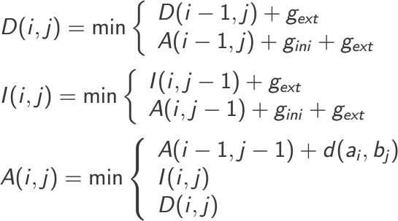
2. COMPUTE THE MATRICES (DISTANCE)
For sequences a = a₁a₂a₃ … a_{m} and b = b₁b₂b₃ … b_{n} , where 1 ≤ j ≤ m and 1 ≤ i ≤ n, we compute the D(i, j), I(i, j) and A(i, j) as follows:

Slide 23
2. (ASIDE) DISTANCE SCORE CALCULATION
Where s(a,b) is the similarity measure between amino acids a and b, specified in the BLOSUM file, the distance measure d(a,b) is given with the following equation:
s(a, a) + s(b, b)
d(a, b) =
– s(a, b)
2

Slide 24
3. TRACE THE MATRICES (DISTANCE)
Traceback method is identical to Step 3 of the similarity alignment

Slide 25
03
PROGRAMMING STRUCTURE

Slide 26
PROGRAMMING STRUCTURE: OVERVIEW
Object-oriented design, alignment classes implemented with a factory design pattern
Six main files:
sequence_reader.py - contains the SequenceReader class, which parses the provided sequence file
blosum_reader.py - contains the BlosumReader class, which parses the provided BLOSUM file
global_aligner_base.py - contains the GlobalAlignerBase class, acts as the base aligner class. Similarity/Distance alignments are implemented by two child classes:
global_distance_aligner.py - contains the GlobalDistanceAligner class
global_similarity_aligner.py - contains the GlobalSimilarityAligner class
main.py - entry file. Reads input arguments, initializes classes, and prints output

Slide 27
PSEUDOCODE: main.py
script main.py(mode, sequences_file, blosum_file)
seqReader <- an instance of the SequenceReader class Read sequences_file into seqReader
if the mode is “distance” then aligner <- an instance of the GlobalDistanceAligner class, scored with blosum_file
else if the mode is “similarity” then aligner <- an instance of the GlobalSimilarityAligner class, scored with blosum_file
end
For each unique pair of sequences (seqA, seqB) in seqReader: Perform an alignment on seqA and seqB using aligner Print the alignment of seqA # ex. “ACCCGVA___T” Print the match symbols # ex. “* *|* *” Print the alignment of seqB # ex. “A___GTAPPPT” Print the alignment score # ex. “Score: 12” end
Terminate the program

Slide 28
STRUCTURE
ENTRY
reads
SequenceReader
obtains sequences from
sequences.txt
main.py
set_sequences(path: String)
computes alignments with
GlobalDistanceAligner
GlobalSimilarityAligner
align(seqA: String, seqB: String)
align(seqA: String, seqB: String)
Inherits from
BlosumReader
reads
read_file(path: String)
get_similarity_score(a: String, b: String)
get_distance_score(a: String, b: String)
obtains scores from
GlobalAlignerBase
blosum.txt
align(seqA: String, seqB: String)

Slide 29
04
USER MANUAL

Slide 30
USER MANUAL: BLOSUM FILE
The BLOSUM file contains an n × n BLOSUM similarity matrix with row and column headers, along with the gap initiation and extension costs for the alignment computation. The BLOSUM file requires the following conditions:
The first line contains the title of the matrix (ex.”BLOSUM62”).
The next non-empty line contains n column labels for the matrix, separated by one or more spaces
The next n non-empty lines contain a row label, and i column values. Every i-th row label is identical to the i-th column label.
The next non-empty line contains the text “Gap_initiation = x”, where x is a (generally negative) integer representing the gap initiation cost.
The next non-empty line contains the text “Gap_extension = x”, where x is a (generally negative) integer representing the gap extension cost.

Slide 31
USER MANUAL: SEQUENCES FILE
The sequences file contains information on the sequences that the alignment will be performed on. For every sequence in the file, the following conditions are required:
The first non-empty line contains the identifying information for the sequence.
The second non-empty line contains the name of the protein, and the species from which it originated (separated by the “-” character).
The third non-empty line contains the sequence, and ends with the “*” character. All characters in the sequence exists in the BLOSUM matrix of the BLOSUM file.

Slide 32
USER MANUAL: RUNNING THE SCRIPT
The script main.py accepts the following arguments
ARGUMENT | TYPE | DESCRIPTION
mode | string | The type of global alignment to be performed. Can be “distance” or “similarity”
blosum_file | string | The path to the BLOSUM file
sequences_file | string | The path to the sequences file

Slide 33
USER MANUAL: UNDERSTANDING THE OUTPUT
The program computes and outputs the alignment of every possible pair of sequences in the provided file. For each pair of sequences, we can understand the output as follows:
The first line contains the protein and species names of both sequences used in the following alignment.
The second line contains the optimal alignment of the first sequence.
The third line contains symbols representing the match status of individual characters in the two sequences. The “*” symbol represents a direct match, the “|” symbol represents a mismatch/substitution, and a space represents an insertion/deletion.
The fourth line contains the optimal alignment of the second sequence.
The final line contains the score of the optimal global alignment.

Slide 34
USER MANUAL: UNDERSTANDING THE OUTPUT
Alignment of hemoglobin alpha chain (human) and myoglobin (olive baboon (tentative sequence))
---------VLSPADKTNVKAAWGKVGAHAGEYGAEALERMFLSFPTTKTYFPHFDLSHGSAQVKGH----------------------------G
**| |****|*|||||*|*|*|*|* *** *
GLSDGEWQLVLN---------VWGKVEADIPSHGQEVLIRLF----------------------KGHPETLEKFDKFKHLKSEDEMKASEDLKKHG
Score: 585.5
Alignment of hemoglobin alpha chain (human) and hemoglobin alpha chain (gayal)
VLSPADKTNVKAAWGKVGAHAGEYGAEALERMFLSFPTTKTYFPHFDLSHGSAQVKGHGKKVADALTNAVAHVDDMPNALSALSDLHAHKLRVDPV
***|***|**********|**|*************************************|***|***|**|*|**|*|***|**************
VLSAADKGNVKAAWGKVGDHAAEYGAEALERMFLSFPTTKTYFPHFDLSHGSAQVKGHGAKVAAALTKAVGHLDDLPGALSELSDLHAHKLRVDPV
Score: 91.0
Alignment of myoglobin (olive baboon (tentative sequence)) and hemoglobin alpha chain (gayal)
GLSDGEWQLVLNV---------WGKVEADIPSHGQEVLIRLF----------------------KGHPETLEKFDKFKHLKSEDEMKASEDLKKHG
**|| ****|||||||*|*|*|*|* *** *
---------VLSAADKGNVKAAWGKVGDHAAEYGAEALERMFLSFPTTKTYFPHFDLSHGSAQVKGH----------------------------G
Score: 586.5
Example Program Output Format

Slide 35
05
DEMO

Slide 36
DEMO: INPUT FILES
sequences.txt (the sequences file)
>P1;HAHU | 1114
hemoglobin alpha chain - human
VLSPADKTNVKAAWGKVGAHAGEYGAEALERMFLSFPTTKTYFPHFDLSHGSAQVKGHGKKVADALTNAVAHVDDMPNALSALSDLHAHKLRVDPVNFKLLSHCLLVTLAAHLPAEFTPAVHASLDKFLASVSTVLTSKYR*
>P1;MYBAO | 1114
myoglobin - olive baboon (tentative sequence)
GLSDGEWQLVLNVWGKVEADIPSHGQEVLIRLFKGHPETLEKFDKFKHLKSEDEMKASEDLKKHGATVLTALGGILKKKGHHEAEIKPLAQSHATKHKIPVKYLELISESIIQVLQSKHPGDFGADAQGAMNKALELFRNDMAAKYKELGFQG*
>P1;GPPMI | 1114
leghemoglobin I - garden pea
GFTDKQEALVNSSSEFKQNLPGYSILFYTIVLEKAPAAKGLFSFLKDTAGVEDSPKLQAHAEQVFGLVRDSAAQLRTKGEVVLGNATLGAIHVQKGVTNPHFVVVKEALLQTIKKASGNNWSEELNTAWEVAYDGLATAIKKAMKTA*
>P1;HABOG | 1114
hemoglobin alpha chain - gayal
VLSAADKGNVKAAWGKVGDHAAEYGAEALERMFLSFPTTKTYFPHFDLSHGSAQVKGHGAKVAAALTKAVGHLDDLPGALSELSDLHAHKLRVDPVNFKLLSHSLLVTLASHLPNDFTPAVHASLDKFLANVSTVLTSKYR*
>P1;HAGT | 1114
hemoglobin alpha-I chain - goat
VLSAADKSNVKAAWGKVGGNAGAYGAEALERMFLSFPTTKTYFPHFDLSHGSAQVKGHGEKVAAALTKAVGHLDDLPGTLSDLSDLHAHKLRVDPVNFKLLSHSLLVTLACHLPNDFTPAVHASLDKFLANVSTVLTSKYR*
>P1;HBMSN1 | 1114
hemoglobin beta chain, minor - mouse
VHLTDAEKSAVSCLWAKVNPDEVGGEALGRLLVVYPWTQRYFDSFGDLSSASAIMGNPKVKAHGKKVITAFNEGLKNLDNLKGTFASLSELHCDKLHVDPENFRLLGNAIVIVLGHHLGKDFTPAAQAAFQKVVAGVATALAHKYH*
>P1;HGSH | 1114
hemoglobin gamma chain - sheep
MLTAEEKASVISLFAKVNVEEVGGEALGRLLVVYPWTQRFFEHFGDLSSADAILGNPKVKGHGKKVLNSFSEGLKQLDDLKGAFASLSELHCDKLHVDPENFRLLGNVLVVVLARRFGGEFTPELQANFQKVVTGVANALAHRYH*
>P1;HBRNW | 1114
hemoglobin beta chains - white rhinoceros
VELTAEEKAAVLALWDKVKEDEVGGEALGRLLVVYPWTQRFFDSFGDLSTPAAVMGNAKVKAHGKKVLHSFGDGVHHLDNLKGTFAALSELHCDKLHVDPENFRLLGNVLVVVLAKHFGKQFTPELQAAYQKVVAGVANALAHKYH*
>P1;HAEKN | 1114
hemoglobin alpha chain - European moose
VLSATDKSNVKAAWGKVGGNAPAYGAEALERMFLSFPTTKTYFPHFDLSHGSAQVKAHGEKVANALTKAVGHLDDLPGTLSDLSDLHAHKLRVDPVNFKLLSHTLLVTLAAHLPSDFTPAVHASLDKFLANVSTVLTSKYR*
>P1;GPFJG2 | 1114
leghemoglobin glb2 - Sesbania rostrata
MGFTEKQEALVNASYEAFKQNLPGNSVLFYSFILEKAPAAKGMFSFLKDSDGVPQNNPSLQAHAEKVFGLVRDSAAQLRATGVVVLADASLGSVHVQKGVLDPHFVVVKEALLKTLKEAAGATWSDEVSNAWEVAYDGLSAAIKKAMS*
blosum.txt (the BLOSUM file)
BLOSUM62
C S T P A G N D E Q H R K M I L V F Y W
C 9
S -1 4
T -1 1 5
P -3 -1 -1 7
A 0 1 0 -1 4
G -3 0 -2 -2 0 6
N -3 1 0 -2 -2 0 6
D -3 0 -1 -1 -2 -1 1 6
E -4 0 -1 -1 -1 -2 0 2 5
Q -3 0 -1 -1 -1 -2 0 0 2 5
H -3 -1 -2 -2 -2 -2 1 -1 0 0 8
R -3 -1 -1 -2 -1 -2 0 -2 0 1 0 5
K -3 0 -1 -1 -1 -2 0 -1 1 1 -1 2 5
M -1 -1 -1 -2 -1 -3 -2 -3 -2 0 -2 -1 -1 5
I -1 -2 -1 -3 -1 -4 -3 -3 -3 -3 -3 -3 -3 1 4
L -1 -2 -1 -3 -1 -4 -3 -4 -3 -2 -3 -2 -2 2 2 4
V -1 -2 0 -2 0 -3 -3 -3 -2 -2 -3 -3 -2 1 3 1 4
F -2 -2 -2 -4 -2 -3 -3 -3 -3 -3 -1 -3 -3 0 0 0 -1 6
Y -2 -2 -2 -3 -2 -3 -2 -3 -2 -1 2 -2 -2 -1 -1 -1 -1 3 7
W -2 -3 -2 -4 -3 -2 -4 -4 -3 -2 -2 -3 -3 -1 -3 -2 -3 1 2 11
Gap_initiation = -10
Gap_extension = -2
Notes:
10 sequences

Slide 37
DEMO
> python3 main.py distance ./input_files/blosum62.txt ./input_files/sequences.txt
> python3 main.py similarity ./input_files/blosum62.txt ./input_files/sequences.txt

Slide 38
THANK YOU

Slide 39
Bibliography
Needleman, Saul B., and Christian D. Wunsch. “A General Method Applicable to the Search for Similarities in the Amino Acid Sequence of Two Proteins.” Journal of Molecular Biology, vol. 48, no. 3, 1970, pp. 443–453., https://doi.org/10.1016/0022-2836(70)90057-4.
Chakraborty, Angana, and Sanghamitra Bandyopadhyay. “FOGSAA: Fast Optimal Global Sequence Alignment Algorithm.” Scientific Reports, vol. 3, no. 1, 2013, https://doi.org/10.1038/srep01746.
Gotoh, Osamu. “An Improved Algorithm for Matching Biological Sequences.” Journal of Molecular Biology, vol. 162, no. 3, 1982, pp. 705–708., https://doi.org/10.1016/0022-2836(82)90398-9.

